Slide 1

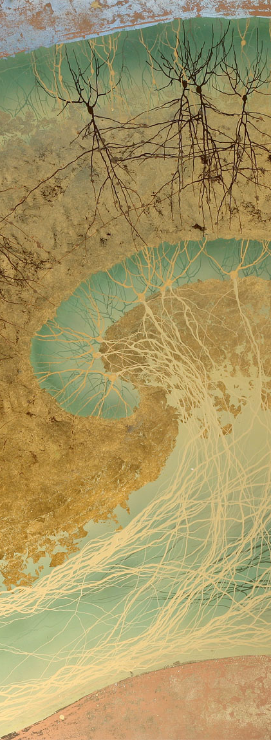
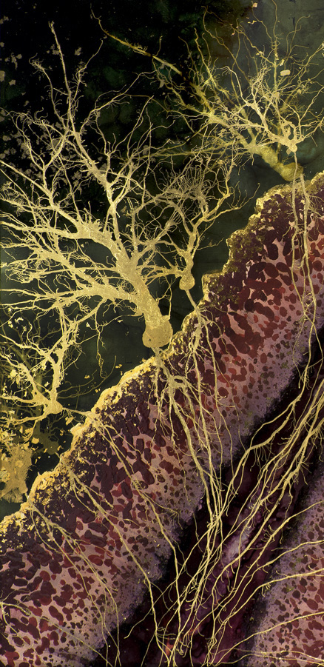
Multi-Class EEG Classification through Neuroevolution
Stellenbosch University
Biomedical Engineering Research Group

Slide 2
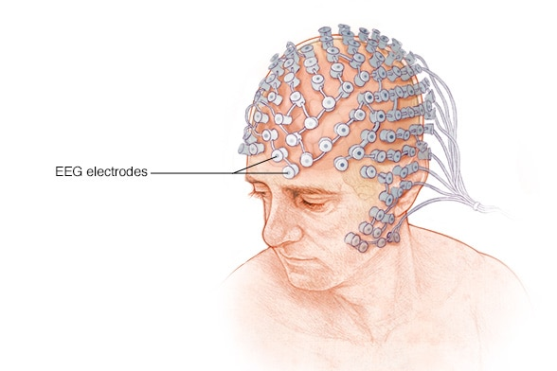
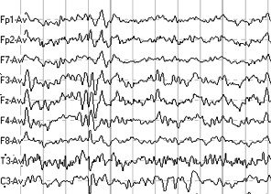
Electroencephalography (EEG)
Electrodes
A monitoring method that records the electrical activity of the brain through electrodes placed on the scalp.

Slide 3
Neuroevolution
… is an evolutionary strategy which can evolve a neural network’s weights, biases and total architecture in response to changes in its overall fitness when performing a task.
… typically implemented as a genetic search.

Slide 4
Project Aim
The aim of this project is to develop deep neural networks capable of multi-class EEG classifications using neuroevolutionary techniques.

Slide 5
Objectives
Network memory
Non-gradient based training algorithm
Modularity
Indirect encoding
Diverse activation functions
Visualization
Compactness
Predictive

Slide 6
Objectives
Benefits generalization and interpretation
Many large problems often have common sub-problems.
Benefits evolvability
Modifying one module does not change another.
Why are biological and engineered systems so effective?
Function is delegated and discretized;
i.e.
distinct modules
A module is something that is:
Domain specific
Limited/specific interaction points
Functionally encapsulated
Characteristic breakdown patterns
(Fodor, J. (1983) The Modularity of Mind, The MIT Press. The MIT Press.)
Modularity
Compactness
Predictive

Slide 7
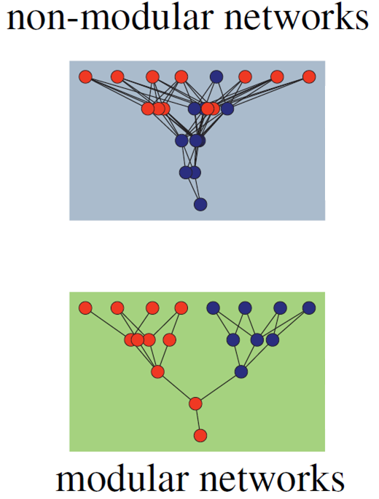
Modularity in neural networks
How do you evolve it?
Varying the (data) environment – using multiple EEG classes
Kashtan, N., Noor, E. and Alon, U. (2007) ‘Varying environments can speed up evolution’
Imposing connection costs
Clune, J., Mouret, J.-B. and Lipson, H. (2013) ‘The evolutionary origins of modularity’

Slide 8
Thank you

